Slide 1
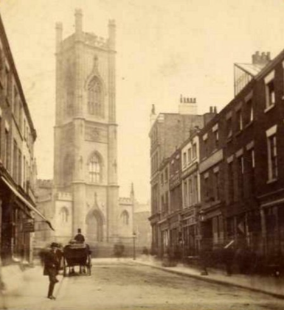
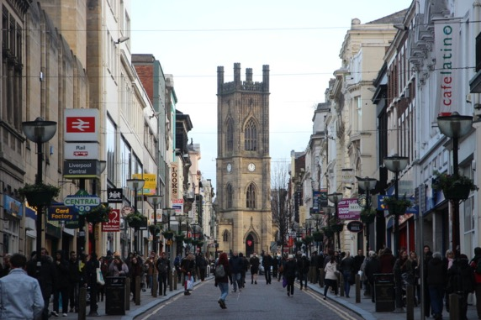
What’s the same? What’s different?
Notes:
Can children guess the year of each photo and how do they know? Explain their thinking (1850 and present day)
What research could they do about the bombed out Church. Linked to local history and WWII.
‘The Liverpool Blitz was the heavy and sustained bombing of the city of Liverpool
and its surrounding area with Bootle and Wirral the most heavily bombed areas of the country outside of London, due to their importance in the British war effort. St Luke's was hit by an incendiary device just after midnight on Tuesday May 6th 1941 and the resulting fire was described by the Liverpool Echo as "magnificent".
Photographs of the clock from the aftermath show the hands at 03.36 meaning that this would have been when the fire reached the upper stories of the tower. Although the bell frame remained intact, 3 of the bells were badly cracked and broken whilst the further 5 bells fell to the floor of the tower.
Only the burned-out shell remains.
Very few of the historic properties could be saved, but among those which were brought out of the reach of the flames were the lectern, two memorial chairs, a memorial desk and most of the altar cloths.
The bells of St Luke's crashed to the ground soon after the fire obtained a fierce hold.
Everyone of the stained glass windows, installed scores of years ago, was destroyed.’ http://www.stlukeliverpool.co.uk/the-destruction/4551084932
Children need to understand that History is not clear cut/ black and white rather shades of grey. There are no right answers, but rather different versions of the truth.

Slide 2
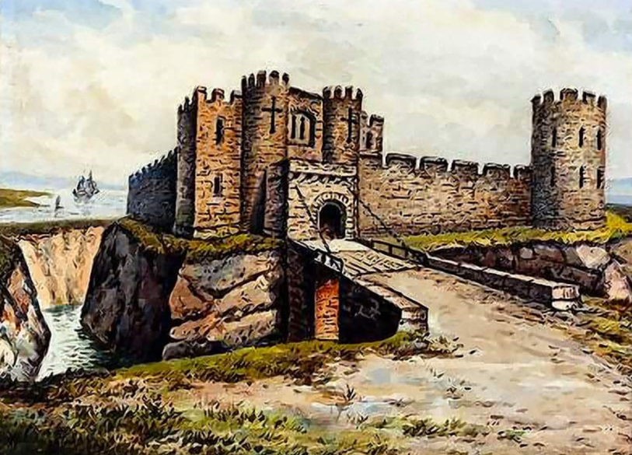
Notes:
For more than 400 years Liverpool castle stood as a strong town fortress and witnessed some significant local historical events. Although no traces of the original structure remain, the site of Liverpool Castle is immortalised in Castle Street within the city environs.
The early history of the castle is somewhat uncertain but it seems probable that it was erected by William de Ferrers sometime in the period 1232-1247. Little is known about this early structure but an inspection of 1347 revealed the castle was comprised of four towers, was surrounded by a dry moat, and included a chapel, bakehouse, brewhouse, herb garden, dovecot and orchard. An inquisition taken in the first year of Edward III (1326-27) found Robert de Holland in possession of the castle and borough of Liverpool, a holding collectively valued at ₤30.10.0.
Over the period 1446-1472 ownership was claimed by Sir Richard Molyneux, who held title as constable of the castle, passing in due course to his son. By 1476 it was clear that the structure required repair and a schedule drawn up for this purpose recommended that the hall and chapel chamber should be covered with shingle, a new chamber to the west was to be covered with stone or mortar, and walls adjoining two of the castle towers were to be covered with turf. Reference is also made to the Gate House and Prison Tower. By 1559 the castle had again slipped into a poor state of repair, and expenditure of ₤150 was suggested in order that the building might be turned into a facility for storage of court rolls.
Finally in 1715 an Act was passed to demolish the castle and build a church in its place. Construction of St George's church begun on the site of the old castle and was consecrated in 1734. By 1825 the church had been pulled down and a new one built in its place.

Slide 3
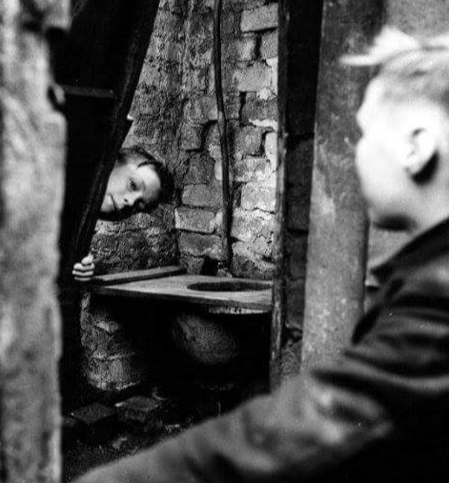
Notes:
What can you see? What is happening? How do you know?
KS1 Encourage use of language : yesterday, past, long ago, now, a long time ago, then
KS2 Encourage use of language : decades, pre/post,
Links with changes within living memory (KS1)
Changes over time – toilets ! (KS2)
Local history

Slide 4
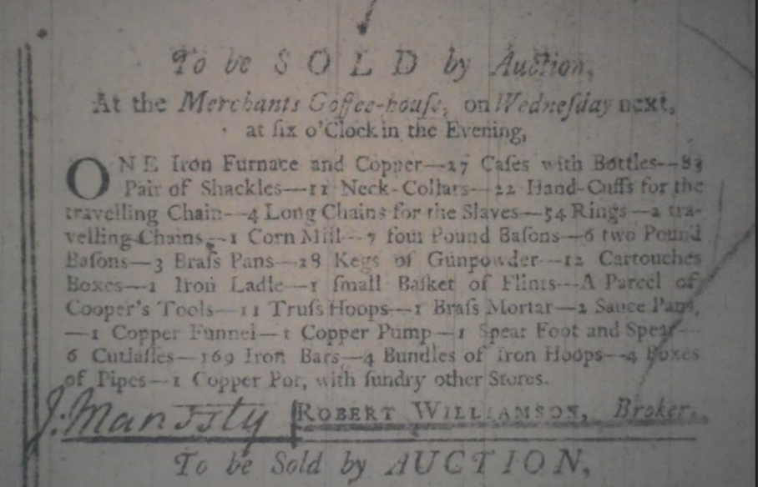
Notes:
UKS2 Only (not appropriate for younger children)
Reasoning
This must be…. because….
I think that…. because….
What are cartouches? trufs hoops? Brafs mortar? What would they be used for?- investigate
Links with local history - slavery

Slide 5
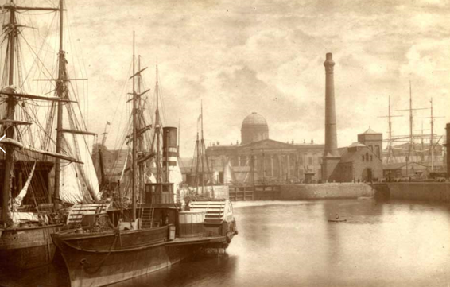
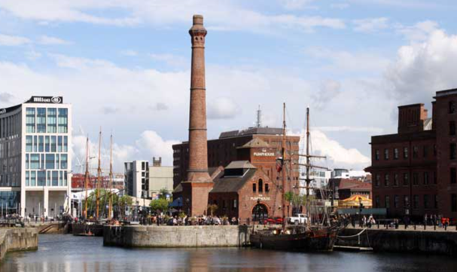
This is different because…
That is the same because…
Notes:
Where is it? How do you know?
How has this changed over time?
What is the same? What is different?

Slide 6
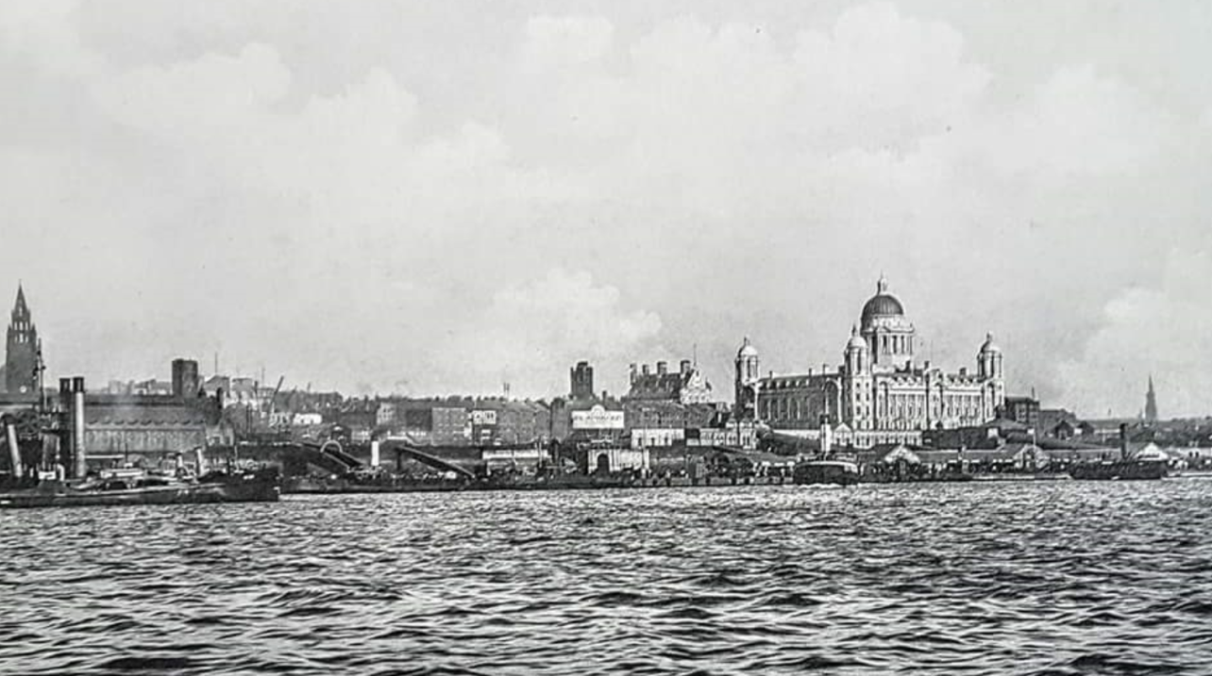
Just one Grace?
Notes:
Just one Grace?- What does that mean? Investigate…
Who do you think would’ve taken this picture? Why?
Where was the picture taken?

Slide 7
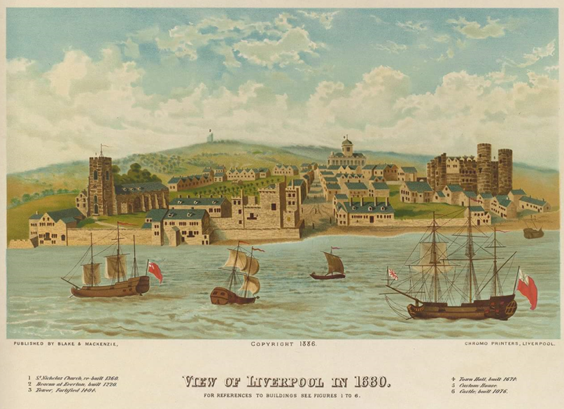
Notes:
Who do you think might have painted this? How accurate do you think that it is? Why?
What period in history is it from? Why do you think this?

Slide 8
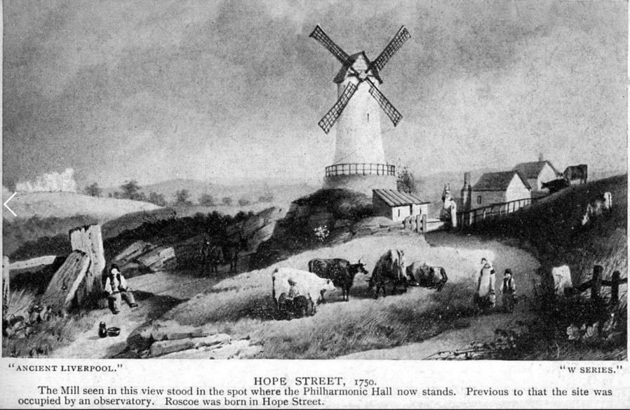
Notes:
Where is this? Why? (Reveal the answer behind the grey box)
Why is the picture entitled ‘Ancient Liverpool’?
What could ‘Roscoe’ be? Why do you think that?

